Slide 1
Traffic Management Using Vehicle Detection and Classification
Under the guidance of
Dr. Siddesh
Associate Professor
(Department Of ISE)
Phani Krishna S (1MS16IS053)
Rakesh M (1MS16IS066)
Nikhil V (1MS16IS047)
Nikhil Krishna M (1MS16IS046)

Slide 2
Problem Statement
Traditional approaches to automated vehicle counting and traffic flow estimation include roadway sensors such as pressure hoses, induction coils, and piezoelectric sensors. These methods are typically inaccurate, complex and sometimes costly in deployment and maintenance. Moreover, all roadway sensors have difficulty in detecting slow and stationary vehicles. The application of computer vision techniques to analyze video sequences to assess the traffic conditions has introduced a huge advantage (Cost, Efficiency, Robustness) and opened the door to an incredible number of applications.

Slide 3
Introduction
The need of efficient management and monitoring of road traffic has increased in last few decades because of the increase in the road networks, the number and most importantly the size of vehicles.
Intelligent traffic surveillance systems are very important part of modern-day traffic management but the regular traffic management techniques such as wireless sensor networks, Inductive loops and EM microwave detectors are expensive, bulky and are difficult to install without interrupting the traffic.
A good alternative is video surveillance systems which have become cheaper and better because of the increase in the storage capabilities, computational power and video encryption algorithms.

Slide 4
The objectives of a traffic surveillance system are to detect, track and classify the vehicles but they can be used to do complex tasks such as driver activity recognition, lane recognition etc.
The traffic surveillance systems can have applications in a range of fields such as, public security, detection of anomalous behaviour, accident detection, vehicle theft detection, parking areas, and person identification.
In this project, we describe a computer vision system used for counting vehicles moving on roads. The system involves analysing a sequence of road images which represent the flow of traffic for the given time period and place.

Slide 5
Vehicle Detection and Counting
Traffic management and planning: If you have a good sense of the volume of traffic moving along a given road or network of roads, you can better understand congestion and then manage and/or make plans to reduce/eliminate it. Vehicle count data is very useful to urban city planners and transport authorities.
Traffic control: No one likes to be stuck behind a red light especially when the road is free. Vehicle counting systems can be integrated with traffic light control software to intelligently direct vehicles based on the current traffic situation in real time.

Slide 6
Parking management: A VCS can be installed at the entrance of a parking lot to monitor vehicles coming in and going out in order to determine whether there are slots available at any given time. It can also be used to ensure the number of vehicles in a given place (such as a hotel or events center) does not exceed its capacity by controlling Automatic Barrier Gates as opposed to issuing tags.
Advertising: Billboard advertisers and their clients are interested in the volume of vehicular traffic along a road where they have ads or where they want to install a billboard because they can make estimates of the number of people who see their ads per time using the data.

Slide 7
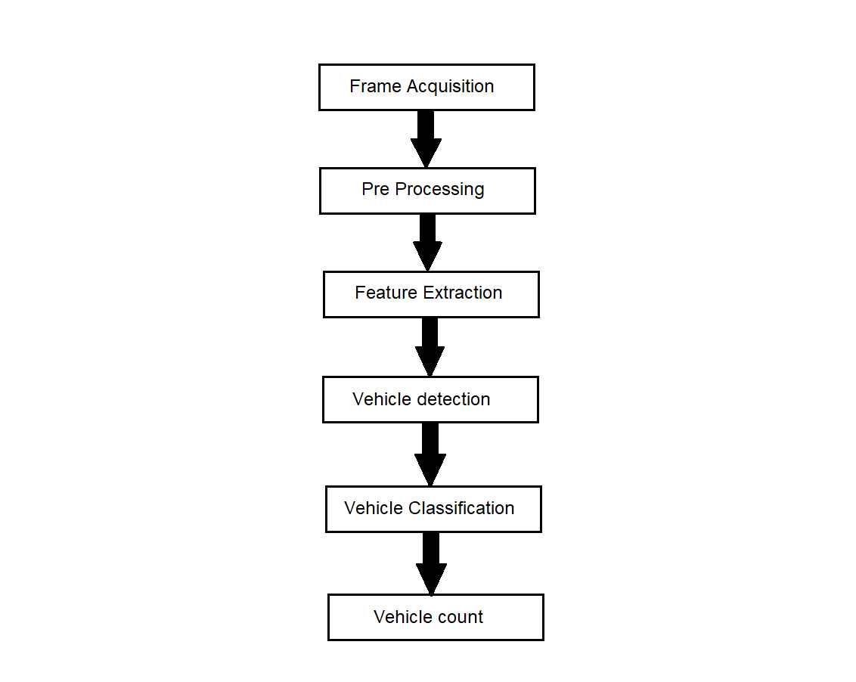
Design Overview

Slide 8
System Design
The system is implemented using two different techniques
Detection, Classification and Counting of Vehicles using YOLO
Detection of Vehicles using Background Subtraction &Classification and Counting using Caffe Model (MobileNet)

Slide 9
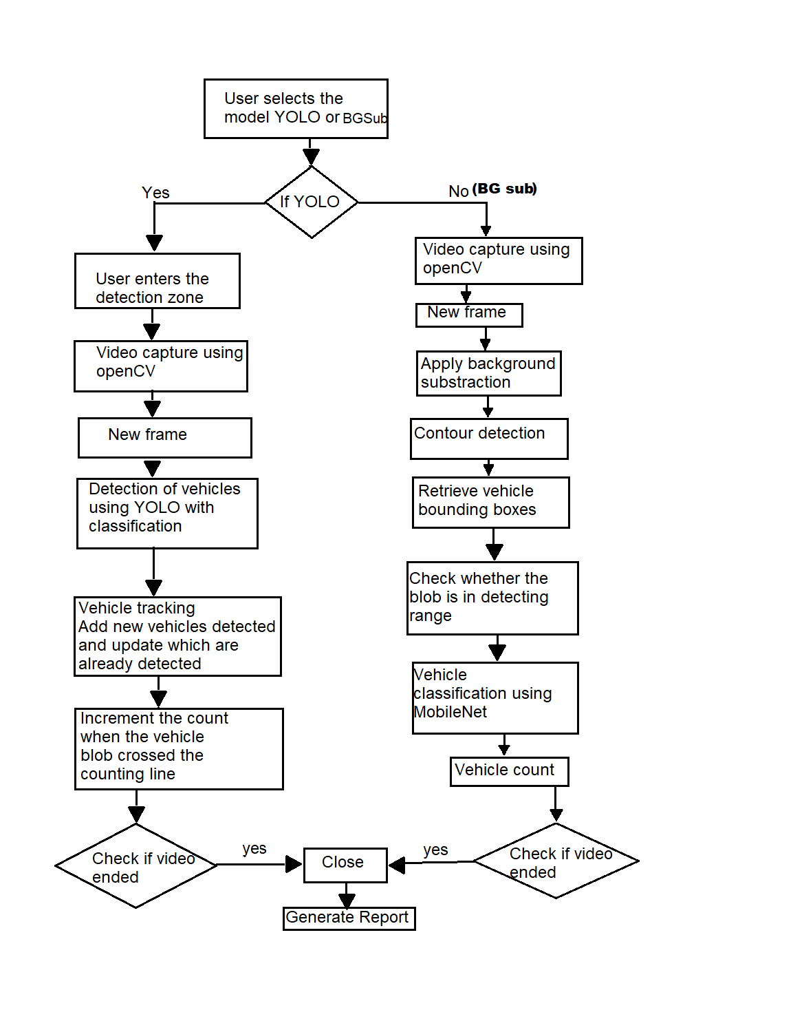
High Level Overview of the Proposed Model

Slide 10
Detection, Classification and Counting of Vehicles using YOLO
“YOLO” is a massive Convolutional Neural network for object detection and classification This network divides the image into regions and predicts bounding boxes and probabilities for each region. These bounding boxes are weighted by the predicted probabilities.
YOLO divides the image into S × S grids and predicts B bounding box and C class probability for each grid cell. Each bounding box consists of five predictions: w, h, x, y, and object confidence. The values of w and h represent the width and height of the box relative to the whole image. The values of (x, y) represent the center coordinates of the box relative to the bounds of the grid cell. The object confidence represents the reliability of existing object in the box.

Slide 11
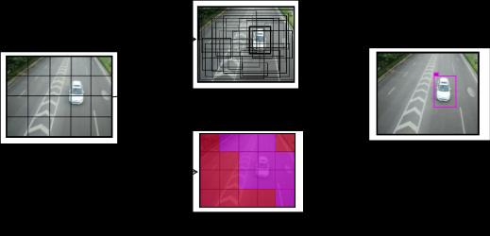
Score (c,i) = p(c) x c(i)
P(c) -> Probability that there is an object in the bounding box
C(i) - > Class of that object
Score is probability that there is an object of certain class

Slide 12
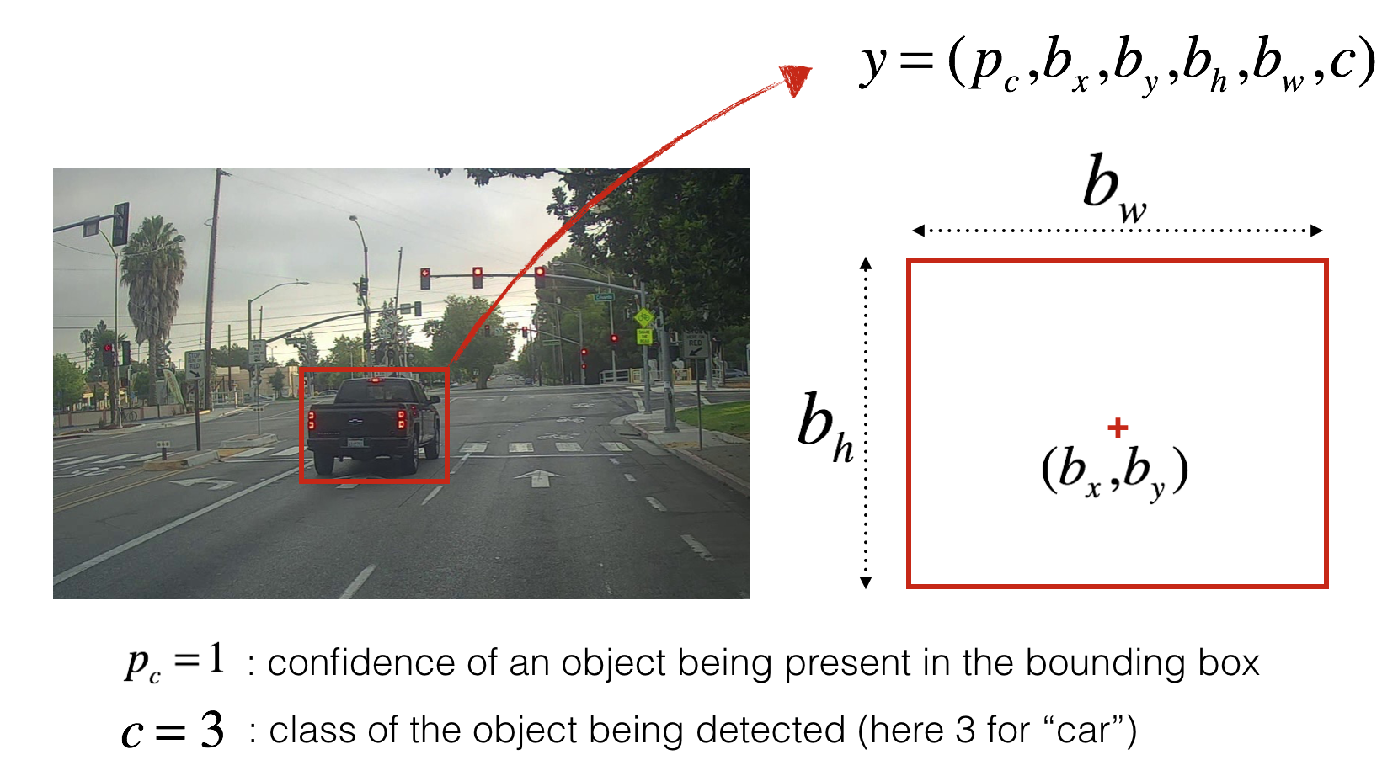
Yolo Output

Slide 13
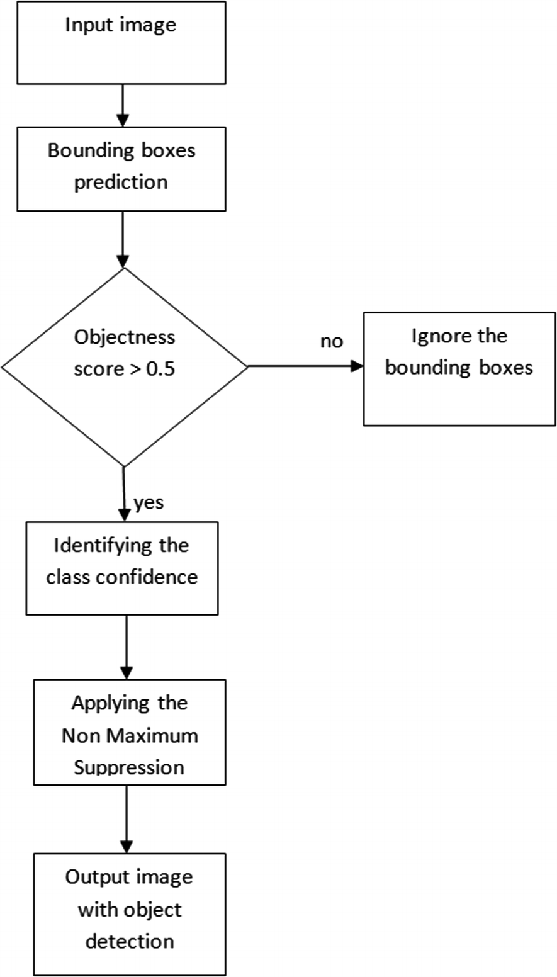
Yolo Algorithm

Slide 14
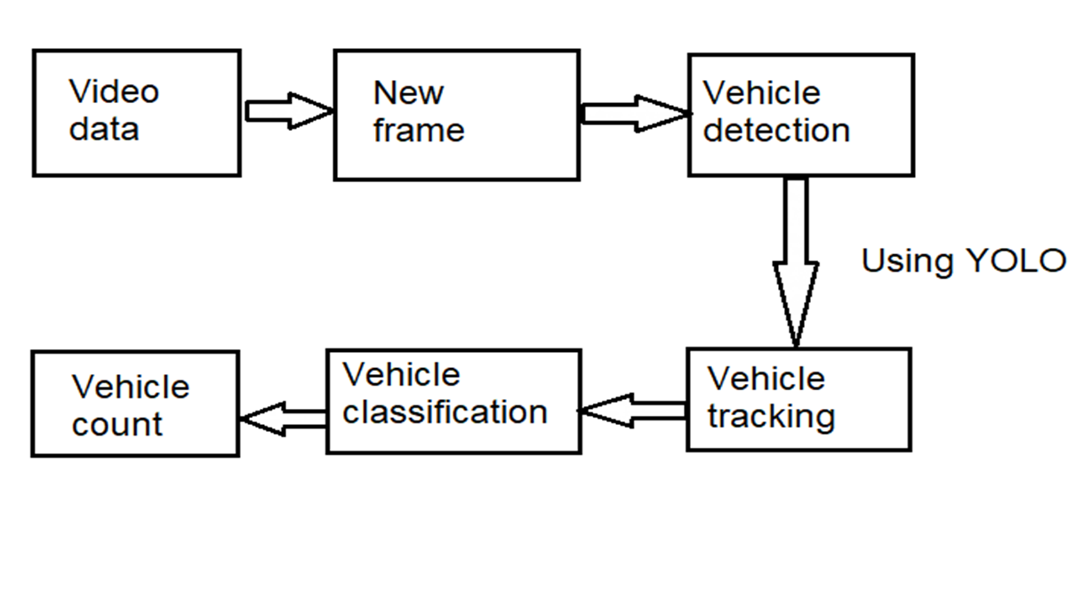
Proposed Model using YOLO

Slide 15
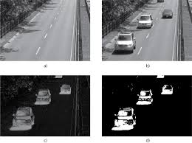
Background Subtraction
Background subtraction is process of extracting foreground objects from maintained background model. A foreground object is any entity that detected by producing difference of every frame of sequence to background model. This result can be further used for tracking targets, motion detection.

Slide 16
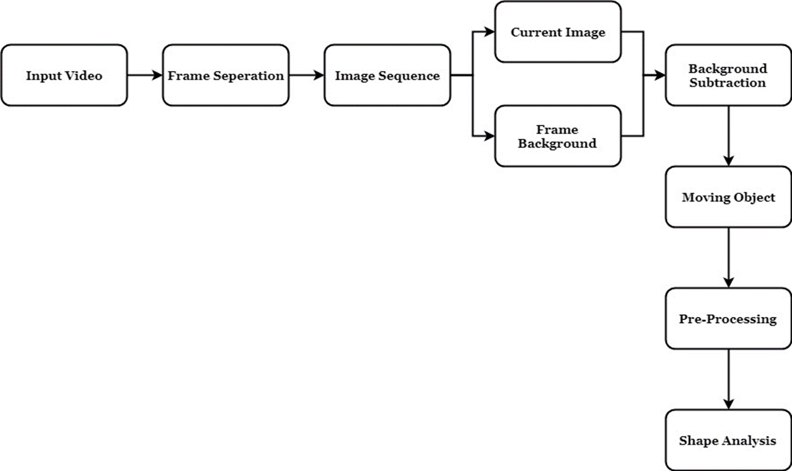
Background Subtraction

Slide 17
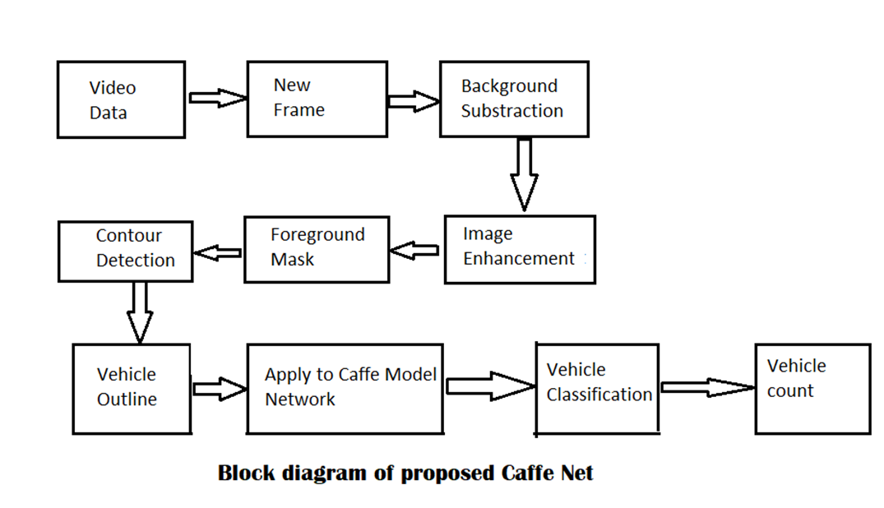
Proposed Model using Background Subtraction and Caffe MobileNet

Slide 18
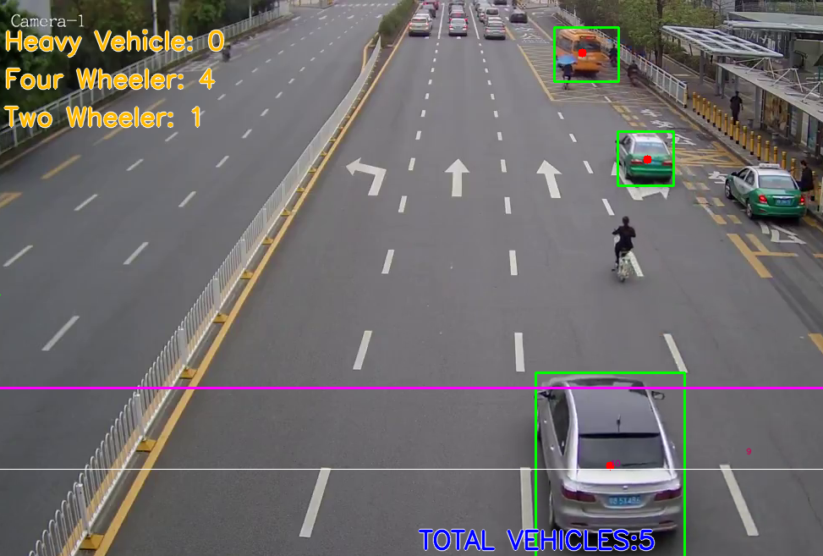
Caffe Model Results

Slide 19
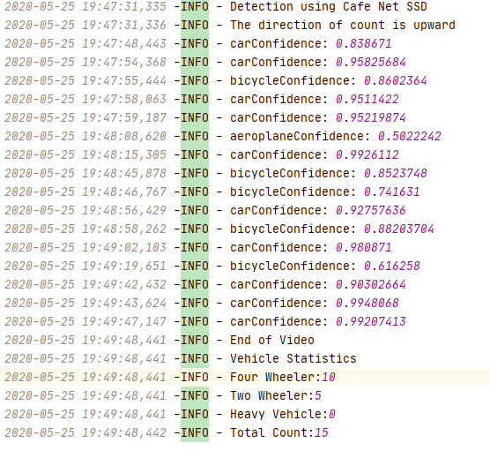
Report Log of Caffe Model

Slide 20
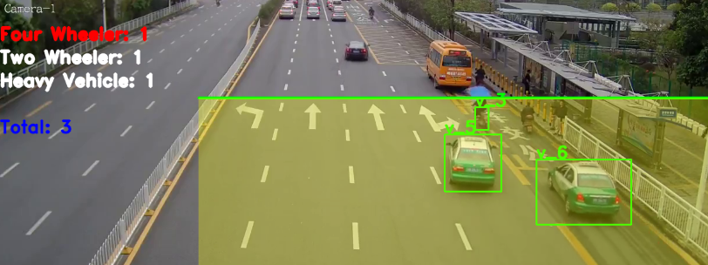
Yolo Results

Slide 21
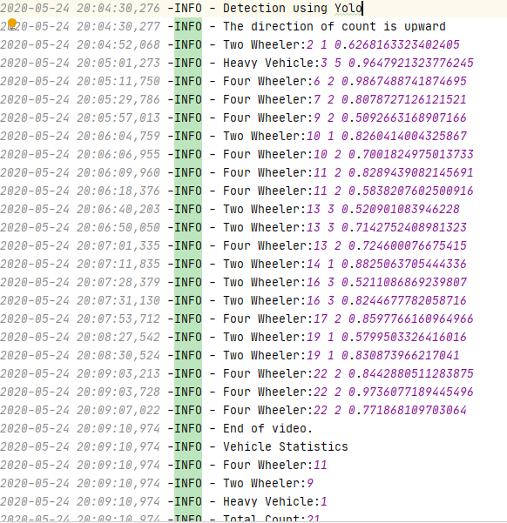
Report Log of YOLO

Slide 22
Thank You

